Slide 1

6th Grade Math
Unit 4, Lesson 3 Plotting, Ordering, and Comparing Decimals Volume 1, pg. 147

Slide 2


Benchmark
MA.6.NSO.1.
Extend previous understanding of numbers to define rational numbers. Plot, order, and compare rational numbers.
volume 1, pg. 147

Slide 3
Integrated Mathematical Thinking and Reasoning Standards
MA.K12.MTR.1.1 Actively participate in effortful learning both individually and collectively.
MA.K12.MTR.3.1 Complete tasks with mathematical fluency.
MA.K12.MTR.4.1 Engage in discussions that reflect on the mathematical thinking of self and others.
MA.K12.MTR.6.1 Assess the reasonableness of solutions.
MA.K12.MTR.7.1 Apply mathematics to real-world contexts.
volume 1, pg. 147

Slide 4

Learning Target
I can plot and compare rational numbers represented as a decimal or percent.
volume 1, pg. 147

Slide 5

Warm-Up
volume 1, pg. 147

Slide 6
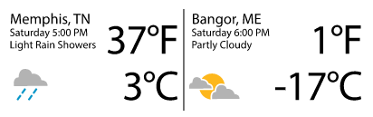

4.3.1 Warm-Up: Notice and Wonder
The diagram gives the temperature, in Fahrenheit $\left(℉\right)$ and in Celsius $\left(℃\right)$, for Memphis, Tennessee, and Bangor, Maine. What do you notice about the temperatures?
volume 1, pg. 147

Slide 7

Guided Instruction
volume 1, pg. 148

Slide 8
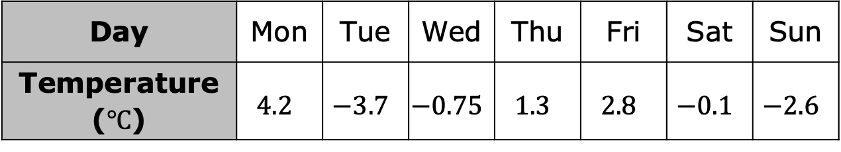

4.3.2 Guided Instruction: Comparing and Ordering Decimals
The table shows the lowest temperature, in degrees Celsius $\left(℃\right)$, for each day during the week of October 14, 2019, in Anchorage, Alaska.
Plot the temperatures on the number line.
Day | Mon | Tue | Wed | Thu | Fri | Sat | Sun
Temperature ($℃$) | $$4.2$$ | $$−3.7$$ | $$−0.75$$ | $$1.3$$ | $$2.8$$ | $$−0.1$$ | $$−2.6$$
volume 1, pg. 148

Slide 9
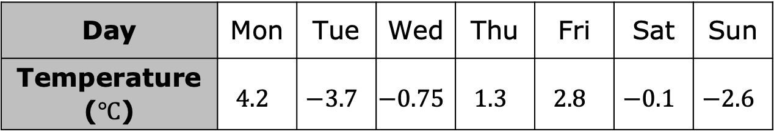
Day | Mon | Tue | Wed | Thu | Fri | Sat | Sun
Temperature ($℃$) | $$4.2$$ | $$−3.7$$ | $$−0.75$$ | $$1.3$$ | $$2.8$$ | $$−0.1$$ | $$−2.6$$
Which temperature did you plot farthest to the left?
What day of the week is represented by the value that was plotted farthest to the left?
Why does the location of the temperature that is plotted farthest to the left help determine which day had the lowermost temperature?
volume 1, pg. 148

Slide 10
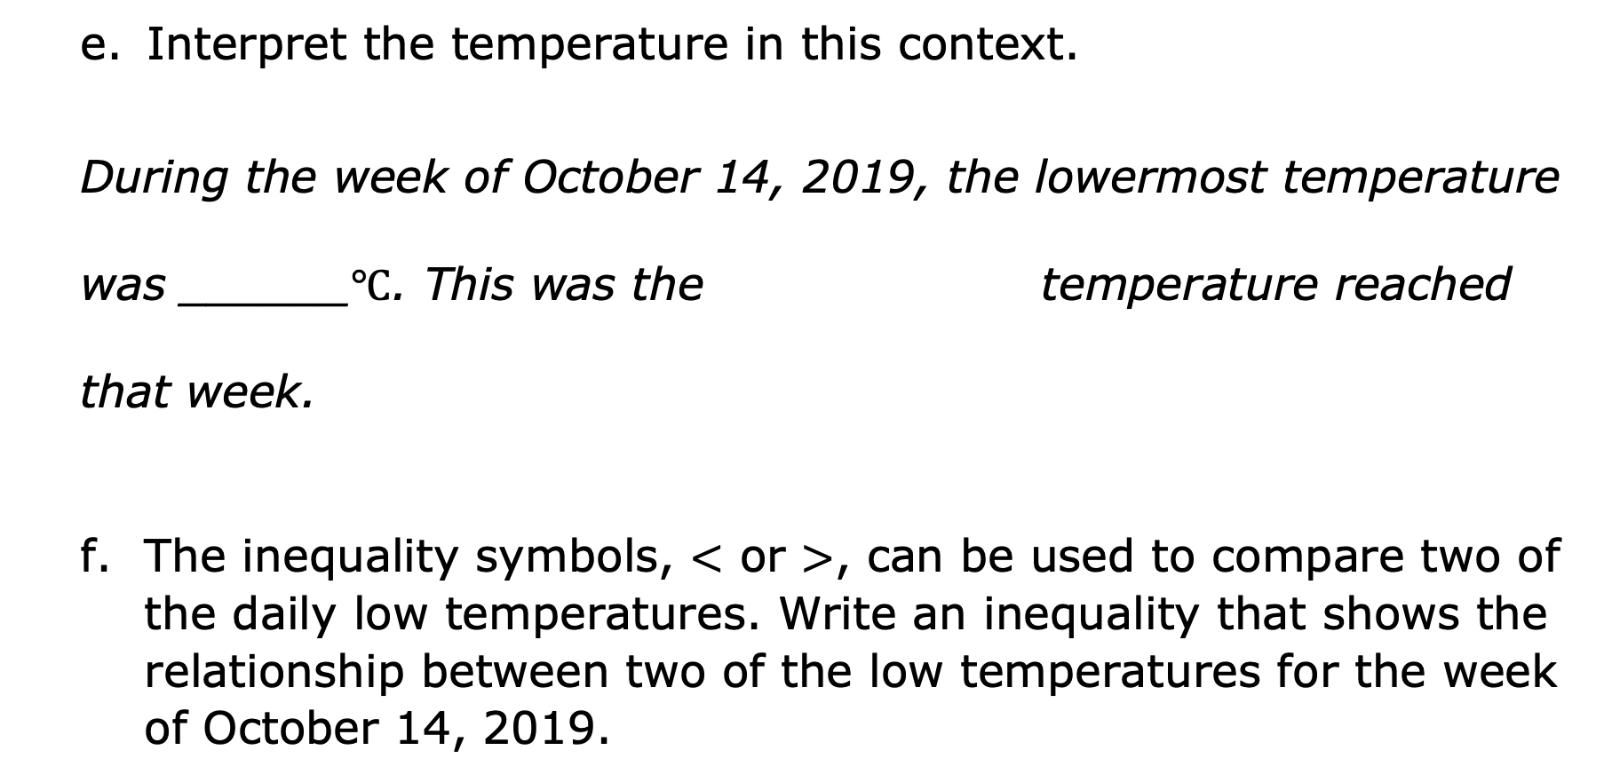
Interpret the temperature in this context.
During the week of October 14, 2019, the lowermost temperature
was ______$℃$. This was the temperature reached
that week.
The inequality symbols, $<$ or $>$, can be used to compare two of the daily low temperatures. Write an inequality that shows the relationship between two of the low temperatures for the week of October 14, 2019.
warmest
coldest
volume 1, pg. 148

Slide 11
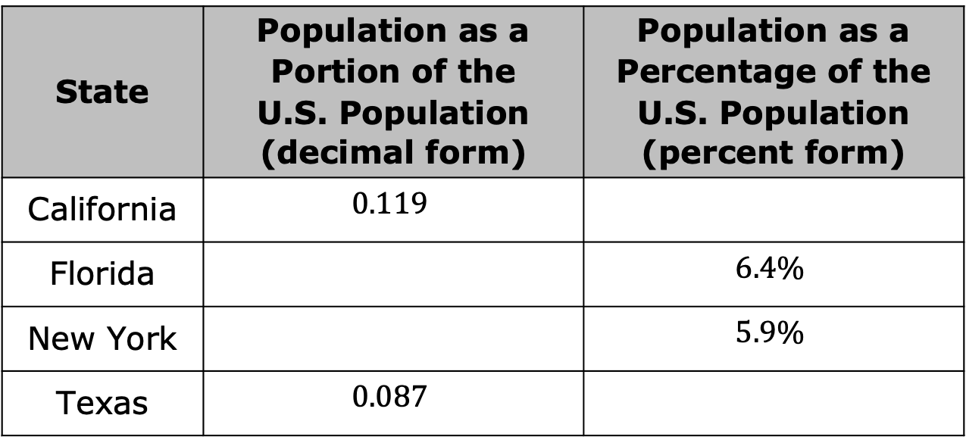
Jayden, a data analyst, is comparing the populations of four different states to the population of the United States. His data is shown in the table.
Choose two states to compare. Write or describe your comparison.
State | Population as a Portion of the U.S. Population (decimal form) | Population as a Percentage of the U.S. Population (percent form)
California | $$0.119$$
Florida |  | $$6.4\%$$
New York |  | $$5.9\%$$
Texas | $$0.087$$
volume 1, pg. 149

Slide 12
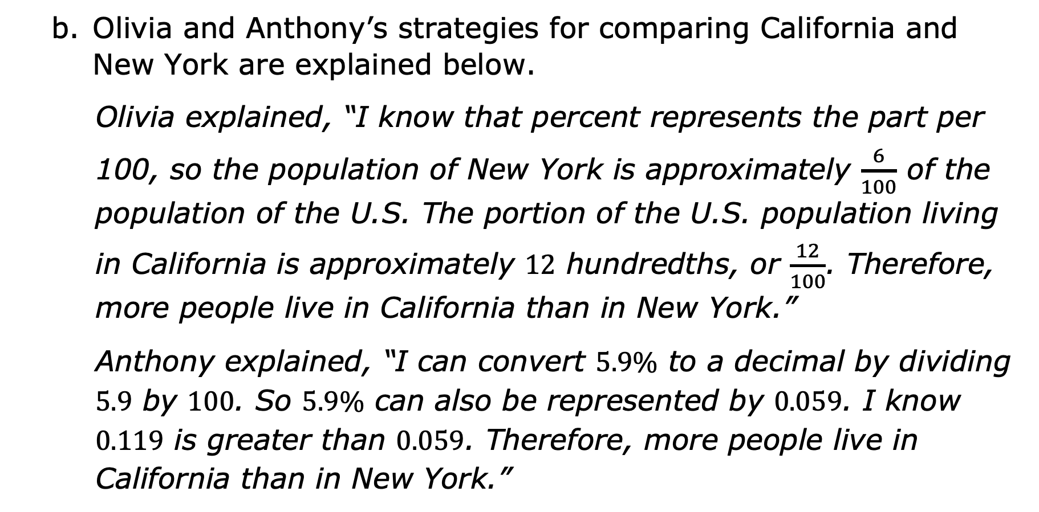
Olivia and Anthony’s strategies for comparing California and New York are explained below.
Olivia explained, “I know that percent represents the part per 100, so the population of New York is approximately $\frac{6}{100}$ of the population of the U.S. The portion of the U.S. population living in California is approximately $12$ hundredths, or $\frac{12}{100}$. Therefore, more people live in California than in New York.”
Anthony explained, “I can convert $5.9\%$ to a decimal by dividing $5.9$ by $100$. So $5.9\%$ can also be represented by $0.059$. I know $0.119$ is greater than $0.059$. Therefore, more people live in California than in New York.”
volume 1, pg. 149

Slide 13
Olivia and Anthony both used different methods to come to the same conclusion. Discuss their methods with a partner.
Olivia’s Method | Anthony’s Method
volume 1, pg. 149

Slide 14
Complete each inequality statement below to compare the given values.
In which of the four states does the highest portion of the U.S. population live?
In which of the four states does the smallest portion of the U.S. population live?
$0.119$ ___ $6.4\%$ | $6.4\%$ ___ $0.087$ | $0.087$ ___ $5.9\%$
volume 1, pg. 150

Slide 15

Collaboration
volume 1, pg. 150

Slide 16

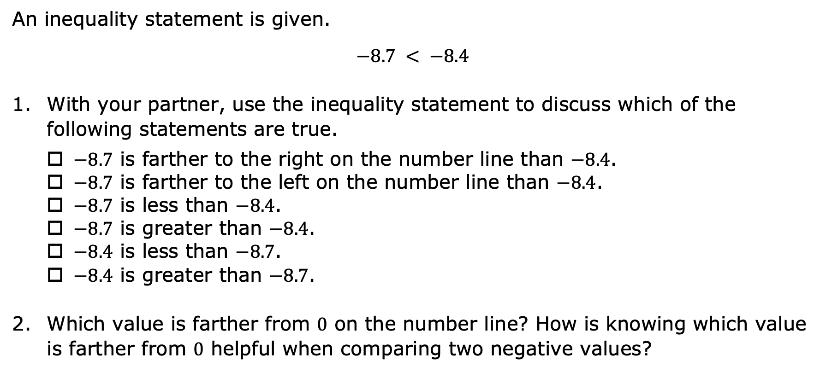
4.3.3 Collaboration: Interpreting Inequality Statements
An inequality statement is given.
$$−8.7 < −8.4$$
With your partner, use the inequality statement to discuss which of the following statements are true.
$−8.7$ is farther to the right on the number line than $−8.4$.
$−8.7$ is farther to the left on the number line than $−8.4$.
$−8.7$ is less than $−8.4$.
$−8.7$ is greater than $−8.4$.
$−8.4$ is less than $−8.7$.
$−8.4$ is greater than $−8.7$.
Which value is farther from $0$ on the number line? How is knowing which value is farther from $0$ helpful when comparing two negative values?
volume 1, pg. 150

Slide 17

Your Turn
volume 1, pg. 151

Slide 18

4.3.4 Your Turn!
Explain why each inequality statement is true or false.
a. $−5.2 < −7.1$
b. $3.1 > 38\%$
c. $−37\% > −25\%$
d. $−12.371 > −12.58$
volume 1, pg. 151

Slide 19
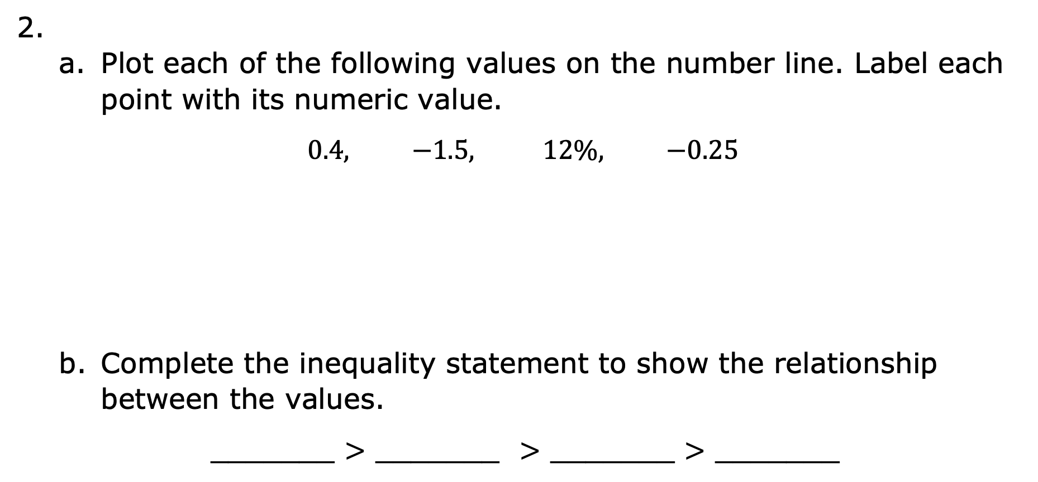
2.
Plot each of the following values on the number line. Label each point with its numeric value.
$$0.4, −1.5, 12\%, −0.25$$
Complete the inequality statement to show the relationship between the values.
_______ $>$ _______ $>$ _______ $>$ _______
volume 1, pg. 151

Slide 20
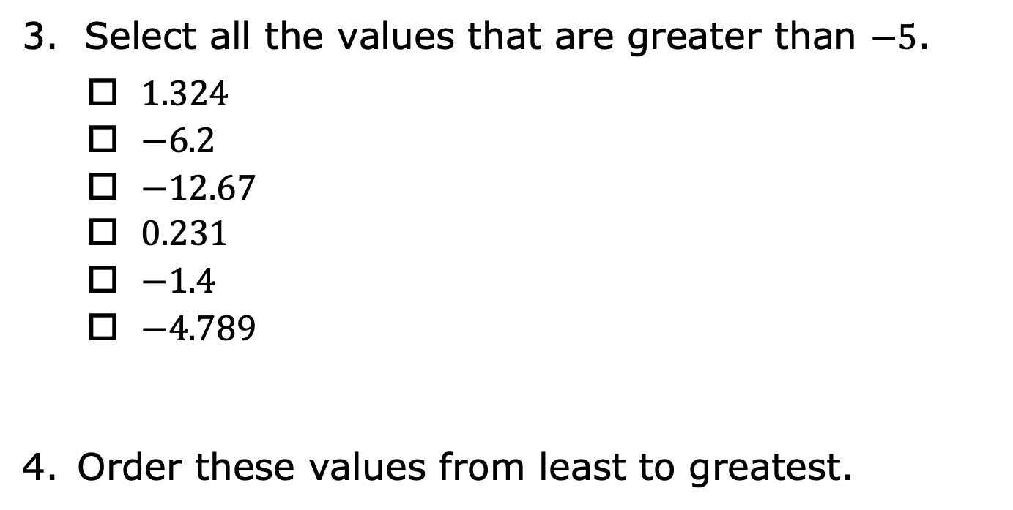
Select all the values that are greater than $−5$.
$1.324$
$−6.2$
$−12.67$
$0.231$
$−1.4$
$−4.789$
Order these values from least to greatest.
$$0.43,$$ | $$−4.2,$$ | $$0,$$ | $$50\%,$$ | $$−1.5,$$ | $$−6.712,$$ | $$19\%$$
volume 1, pg. 151

Slide 21

Wrap-Up
volume 1, pg. 152

Slide 22
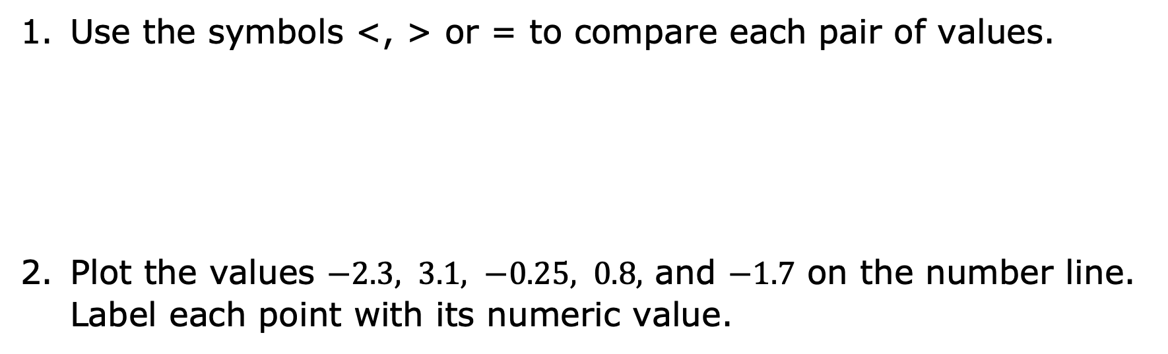
4.3.5 Wrap-Up: Ticket Out the Door
Use the symbols <, > or = to compare each pair of values.
Plot the values $−2.3, 3.1, −0.25, 0.8,$ and $−1.7$ on the number line. Label each point with its numeric value.
$−2.4$ ___ $−1.3$ | $0.5$ ___ $20\%$ | $−15.21$ ___ $−7.136$
volume 1, pg. 152

